Slide 1


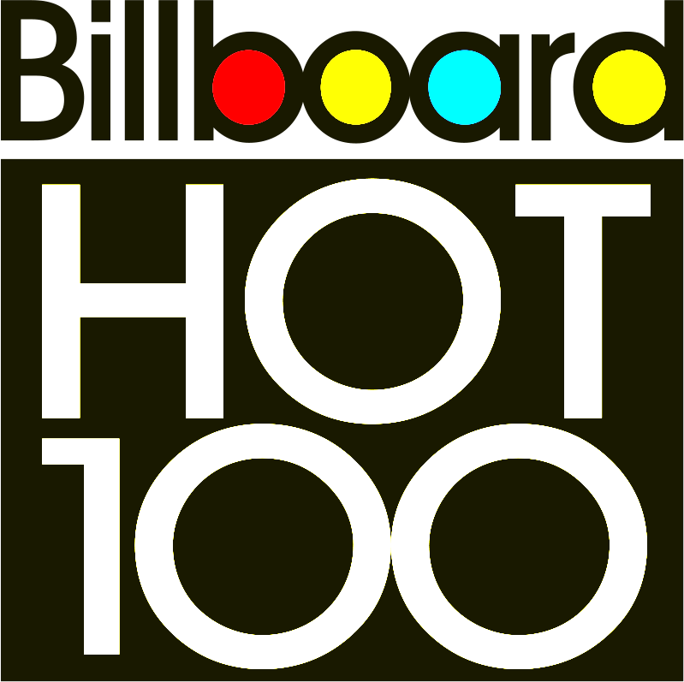
Song Popularity
ThePhoto by PhotoAuthor is licensed under CCYYSA.
Exploring how genres, artists and songs have been ranked as most popular or most listened to from 1958 to 2024 compared to other Music Critic and companies.
Presented By:
Adam Raffel
Ariana Breckenridge
Jared Pavlik

Slide 2
Hypothesis & background
Bias within each data collected and not in accurate representation with society’s listeners
Our Null Hypothesis is as follows:
THAT DATA COLLENECTION AGENCIES HAVE NO BEARING ON THE SONGS ARITST AND GENRES THAT ARE POPULAR,
EACH DATA FRAME SHOULD SHARE SIMILAR VALUES
We all have different music taste and the music we choose could say a little about us
Prevalence of certain genres, artist and songs in the top 100 might reflet a shift in music taste over the years

Slide 3
How are the Data frames generated?
Billboards hot 100
ROLLING STONE TOP 500
Calculated with a point system
Several Contributing Factors such as; streaming activity, radio plays and sales
Survey of industry professionals, critics and figure heads.

Slide 4

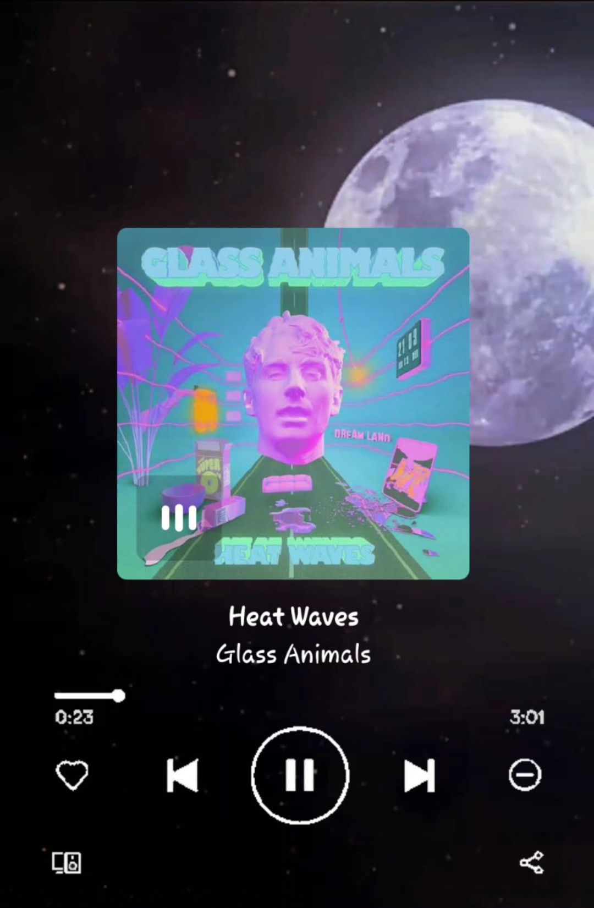

Have you heard this song?
Heat Wave by Glass Animals

Slide 5
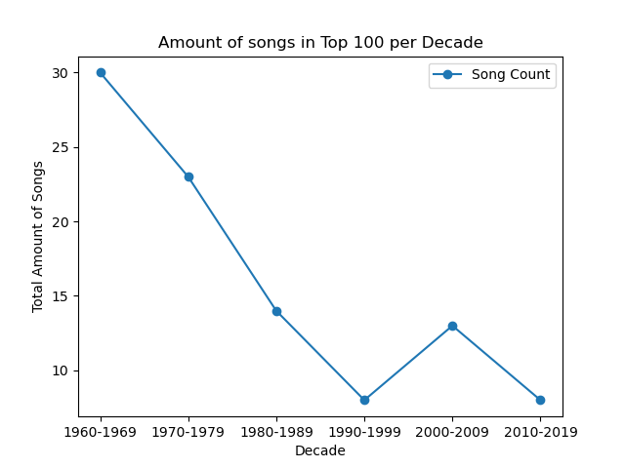
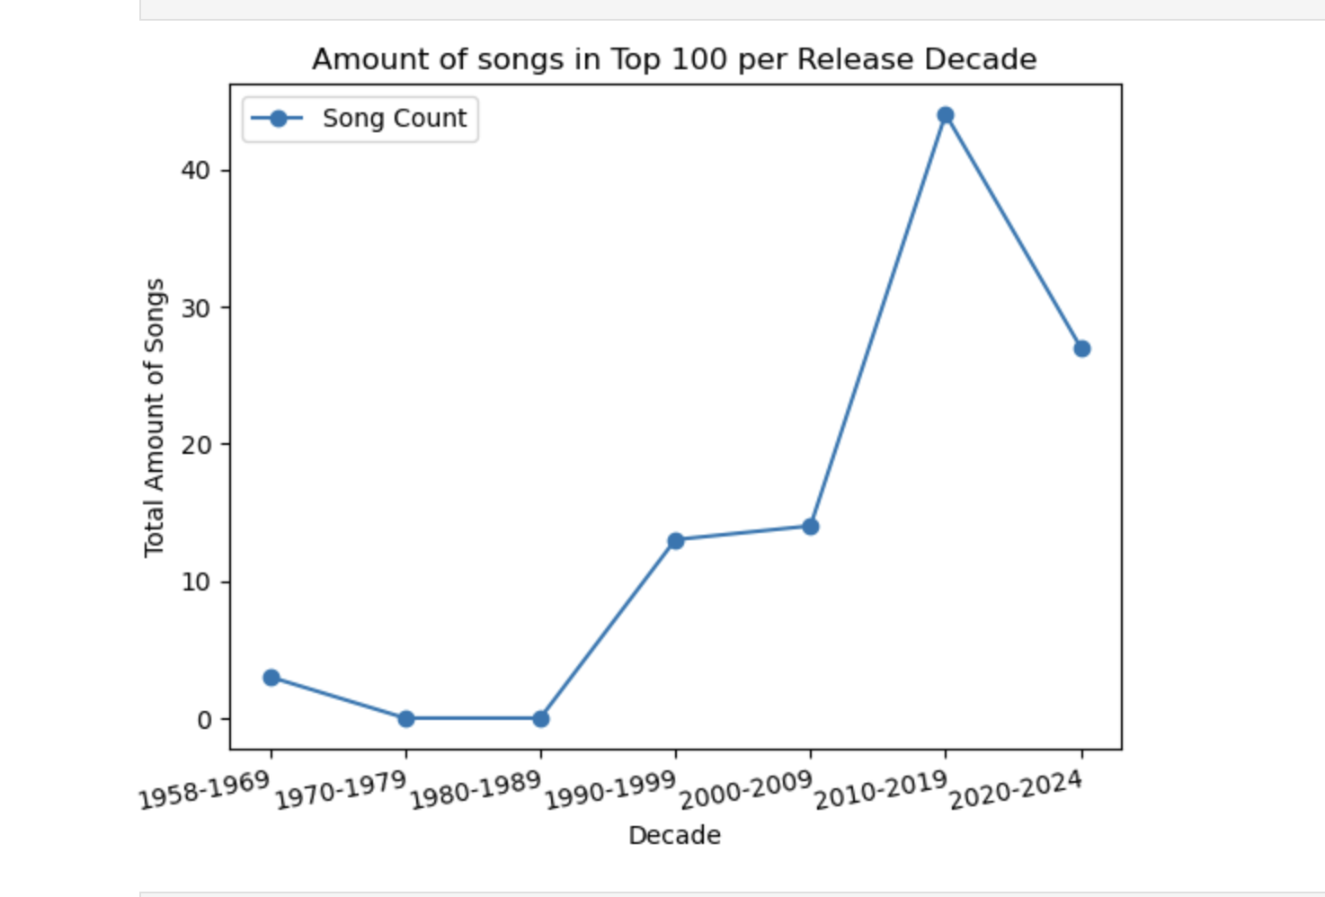
What are the most popular decades on each list?
Rolling Stone 500
Billboards Hot 100

Slide 6
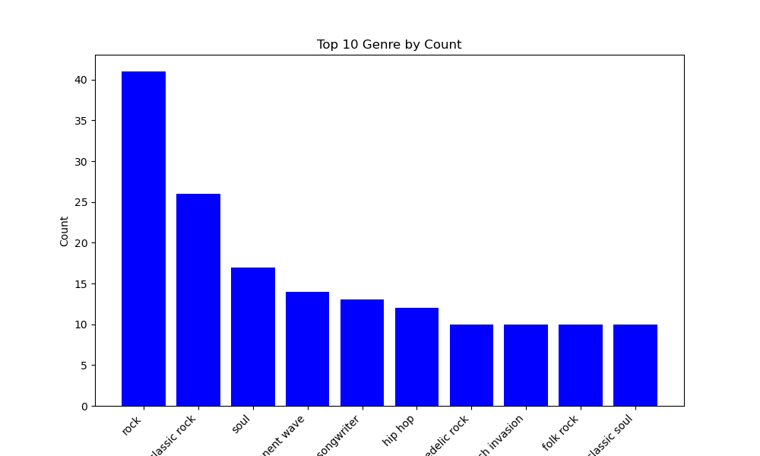
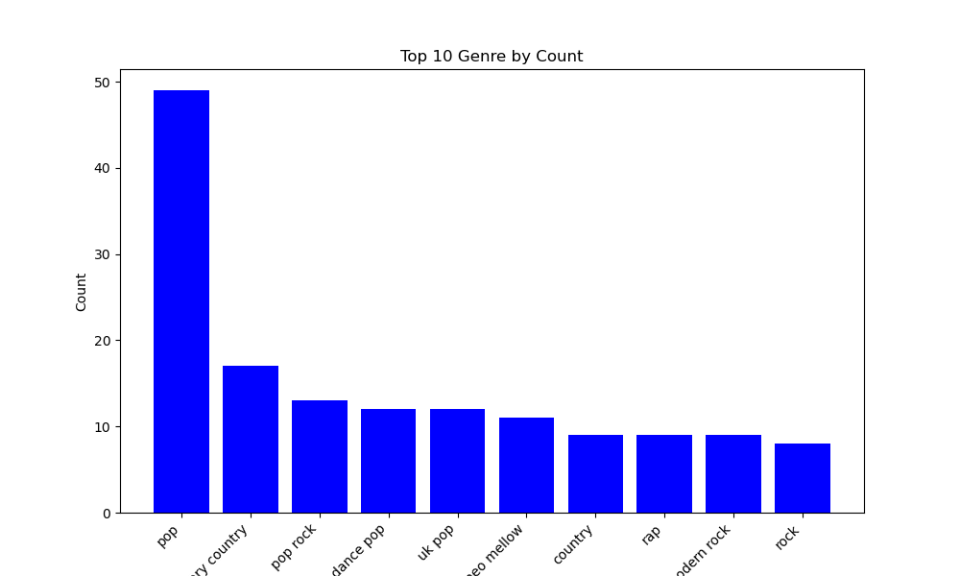
WHAT ARE THE MOST POPULAR GENRES PER DATA BASE?
Rolling Stone’s Hot 500
Billboard's Hot 100

Slide 7
TOP 5 SONGS PER DATA BASE
Rolling Stone Top 500 – top 5 songs
Billboards Hot Top 100 – Top 5 Songs
Artist | Song | Year
Arethra Franklin | Respect | 1967
Public Enemy | Fight the power | 1989
Sam Cooke | A Change is gonna come | 1964
Bob Dylan | Like a Rolling Stone | 1965
Nirvana | Smells like Teen Spirit | 1991
Artist | Song | Year
Glass Animals | Heat Waves | 2021
The Weekend | Blinding Lights | 2019
Imagine Dragons | Radioactive | 2012
AWOLNATION | SAIL | 2011
Jason Mraz | Im yours | 2008

Slide 8
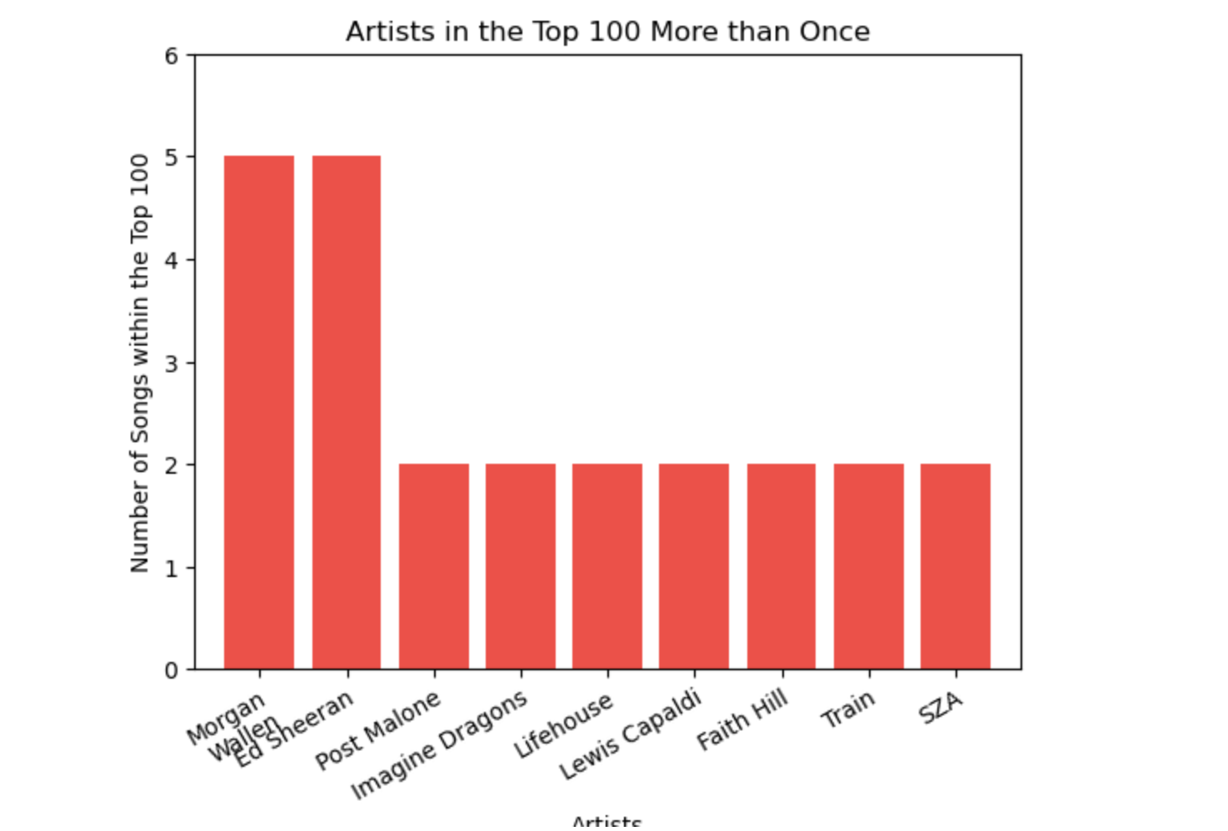
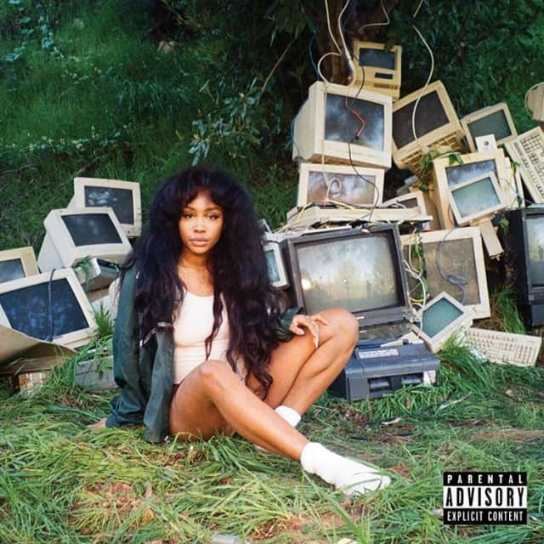
What are the most popular artist on billboard?
These artist were ranked as most popular with having repeatedly been on the chart more than once

Slide 9
Spotify API pull
Spotify’s popularity Score is a number between 0 and 100, this number is calculated with an algorithm referring several factors.
Number of plays, share of total plays, user engagement and skip rate.
Artists with scores closer to 50 are more likely to be featured in official Spotify playlist vs. artists with scores closer to 30 are likely to be featured in DJ mixes

Slide 10
TOP 5 SONGS BILLBOARDS POPULARITY
Billboards Hot 100 – Top 5 songs with Popularity Scores
Rolling stone – Top 5 songs with popularity scores
Artist | Name | Year
Taylor Swift | All Too Well | 2012
Kayne West | Runaway | 2010
Kendrick Lamar | Alright | 2015
Daddy Yankee Glory | Gasolina | 2010
Adele | Rolling in the Deep | 2011
Artist | Name | Year
Taylor Swift | Anti-Hero | 2022
The Weekend | Blinding Lights | 2019
The Weekend/ Ariana Grande | Save your tears | 2021
Post Malone | Circles | 2019
Post Malone | Better Now | 2018

Slide 11
Artist | Song | Year
Aretha Franklin | Respect | 1967
Public Enemy | Fight the power | 1989
Sam Cooke | A Change is gonna come | 1964
Bob Dylan | Like a Rolling Stone | 1965
Nirvana | Smells like Teen Spirit | 1991
Artist | Name | Year
Taylor Swift | All Too Well | 2012
Kayne West | Runaway | 2010
Kendrick Lamar | Alright | 2015
Daddy Yankee Glory | Gasolina | 2010
Adele | Rolling in the Deep | 2011
Rolling Stone Tables
Artist | Song | Year
Glass Animals | Heat Waves | 2021
The Weekend | Blinding Lights | 2019
Imagine Dragons | Radioactive | 2012
AWOLNATION | SAIL | 2011
Jason Mraz | Im yours | 2008
Artist | Name | Year
Taylor Swift | Anti-Hero | 2022
The Weekend | Blinding Lights | 2019
The Weekend/ Ariana Grande | Save your tears | 2021
Post Malone | Circles | 2019
Post Malone | Better Now | 2018
Billboard's Tables

Slide 12
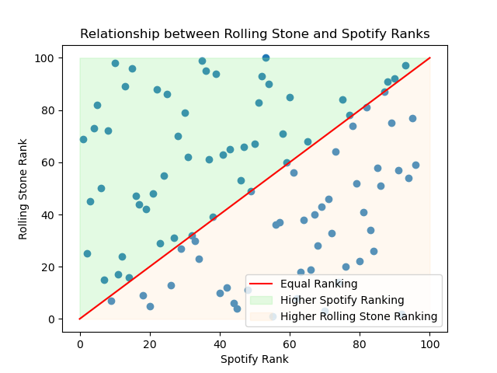
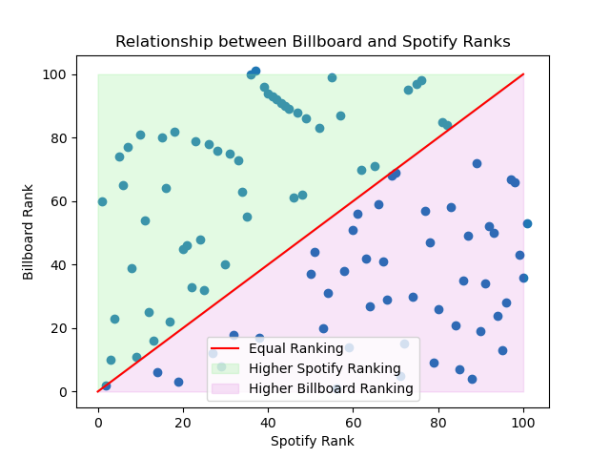
Spotify ranks per Data frame

Slide 13
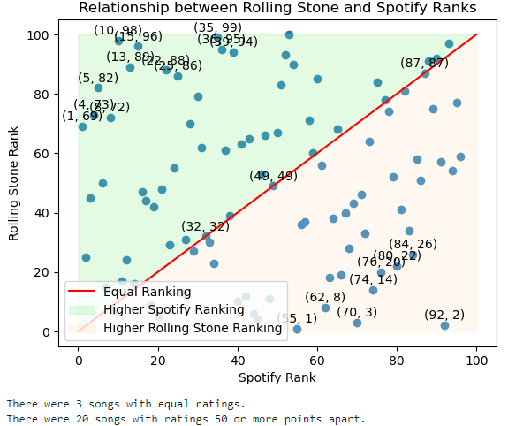
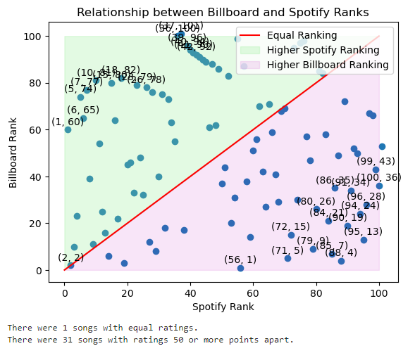

Slide 14
ANALYSIS & Conclusion
Top 100 song list to perspective and consistent to populist
Our csv’s showing the decade popularity shows the inverse, based on certain criteria

Slide 15
resources
https://github.com/HipsterVizNinja/random-data/tree/main/Music/hot-100
https://data.world/kcmillersean/billboard-hot-100-1958-2017
https://github.com/HipsterVizNinja/random-data/tree/main/Music/rs-500
https://www.usatoday.com/story/entertainment/music/2022/01/26/heat-waves-glass-animals-dave-bayley-interview/9214768002/
https://spotipy.readthedocs.io/en/2.24.0/
https://www.forbes.com/sites/maryroeloffs/2024/04/30/americans-listen-to-far-more-radio-than-podcasts-even-young-people-new-data-shows/

